Slide 1
EDA ANALYSIS
Getting a brief understanding of how a bank operates when it comes to giving out credit. Understand the parameters used while making a decision for Approving or Rejecting a loan application.

Slide 2
Applying EDA in a real business scenario…
Develop a basic understanding of risk analytics in banking and financial services and understand how data is used to minimise the risk of losing money while lending to customers.
The loan providing companies find it hard to give loans to the people due to their insufficient or non-existent credit history.
Using EDA to analyse the patterns present in the data and ensuring that the applicants capable of repaying the loan are not rejected.

Slide 3
Information on the dataset.
The data frame given contains the information about the loan application at the time of applying for the loan and the application’s result i.e. Approved or Rejected
Any previous application submitted by the client and its result.
The dataset contains two scenarios that client had payment difficulties. This includes the defaulters on the loan as well as the clients who made late payments on the loan. The other scenario is of the clients who made timely payments as well as squared off their loans.

Slide 4
Decisions by the client/bank
Approved: The Bank has approved loan Application.
Cancelled: The client cancelled the application sometime during approval.
Refused: The Bank rejected the loan.
Unused offer: Loan has been cancelled by the client but on different stages of the process.

Slide 5
EDA Objective
Identify patterns which indicate if a client has difficulty paying their instalments which may be used for taking actions such as denying the loan, reducing the amount of loan etc.
Understanding the reasons or factors behind the defaulting on NPA’s for a bank.
Utilising the insights drawn from this study to improve risk management and lending powers of the bank.

Slide 6
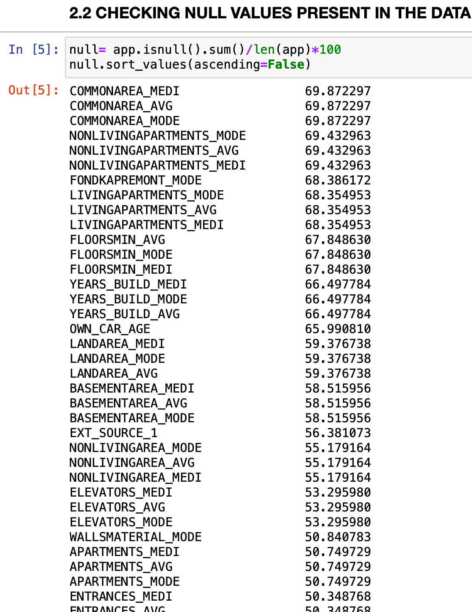
Understanding the data
First and foremost step in analysis is to check for missing values.
In our data there were a number of columns(122 to be precise) and some what 40 columns had null entries present in them.
Now these null-entries after being calculated were found to be >40% for these 40 columns.
Hence a decision was taken to drop these columns as they were insignificant for our analysis.

Slide 7
Imputation for remaining null value columns
Imputing the values is a quick and easy way to deal with null values in a column.
We have performed 2 types of imputation: 1. With median for columns with outliers. 2. With mean for columns without outliers.

Slide 8
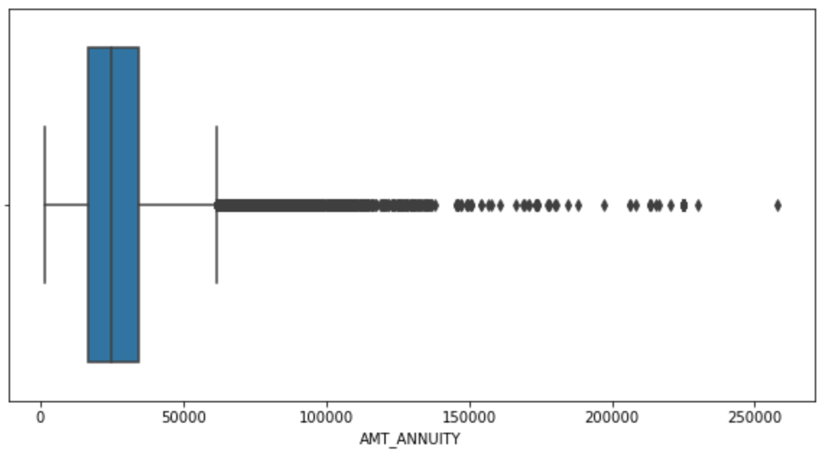
Column with outliers
A column named AMT_ANNUITY had outliers present.
We came to know about this using boxplot.
Thus we imputed it with the median values as the provide a more balanced approach when dealing with null values where a number of values are so high that taking a mean would further push them out.

Slide 9
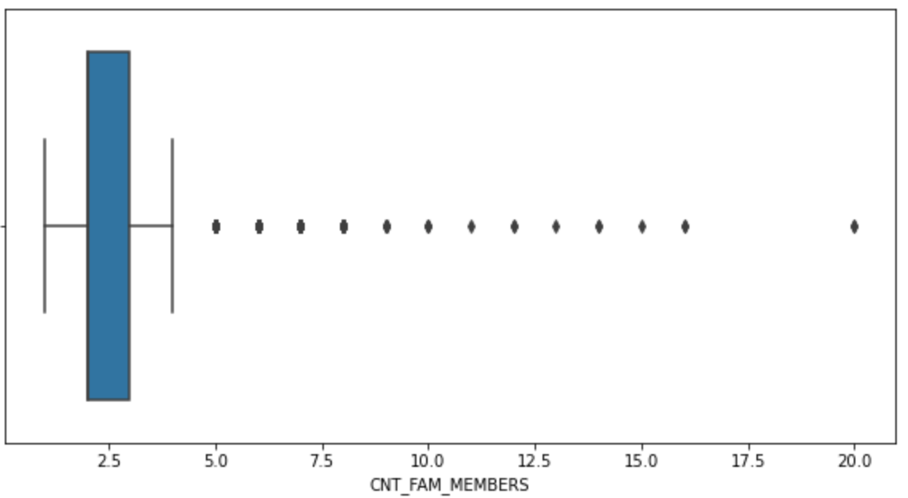
Column with outliers
Same for a column of family members where the max value reached out to 20

Slide 10
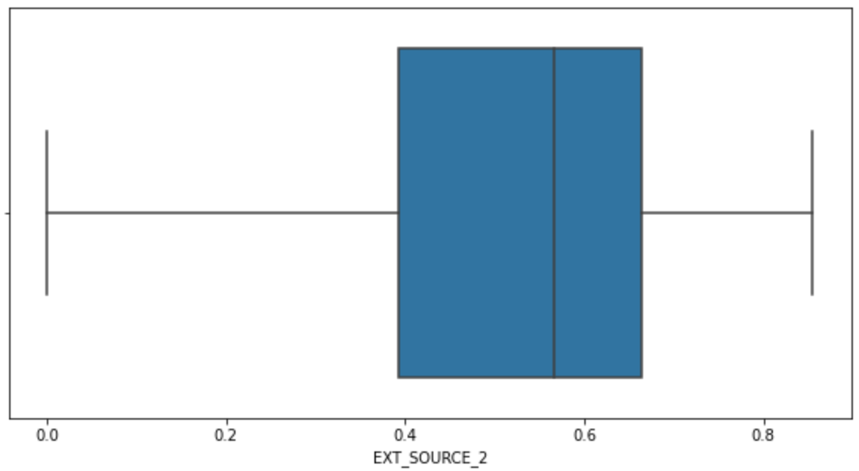
Column without outliers
A column named EXT_SOURCE_2 had no outliers present.
We came to know about this using boxplot.
Thus we imputed it with the mean values as the mean values represent the overall values present in the column.

Slide 11
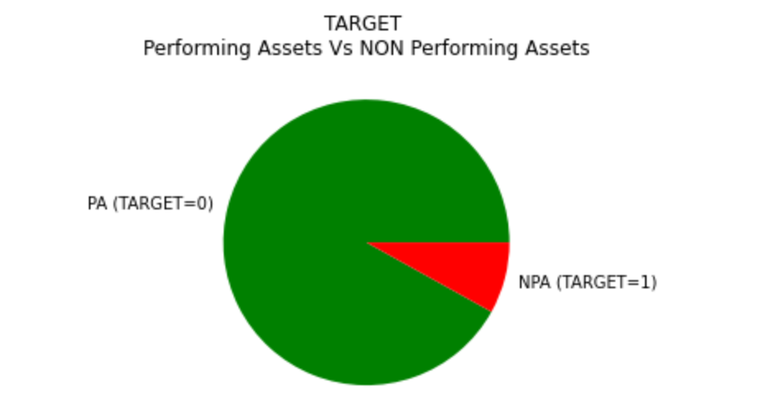
Imbalance in the data
There is a certain and significant data imbalance present. As we can see that 90% of the people who took loan did not default.
Maybe their amounts were very low when compared to the defaulters but that seems highly unlikely.

Slide 12
Steps to analyse the imbalance in the data
We split the data into two separate data frames.
Identified the categorical and numerical columns separately.
Performed Univariate and Bivariate analysis on them.
Generate a correlation between the dataset.

Slide 13
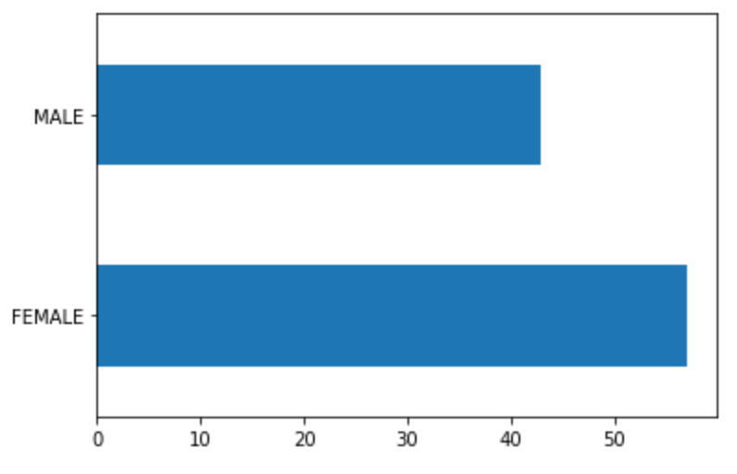
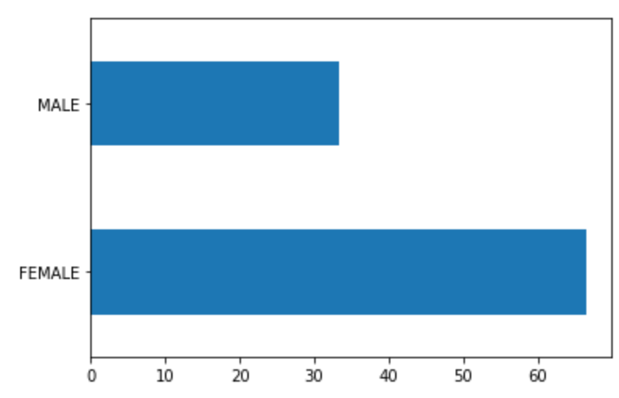
Univariate Analysis
We can see that Female contribute to the non-defaulters as well as to the defaulters.
We can conclude that we see more female applying for loans than males and hence the more number of female defaulters as well.
But the rate of defaulting of FEMALE is much lower compared to their MALE counterparts.

Slide 14
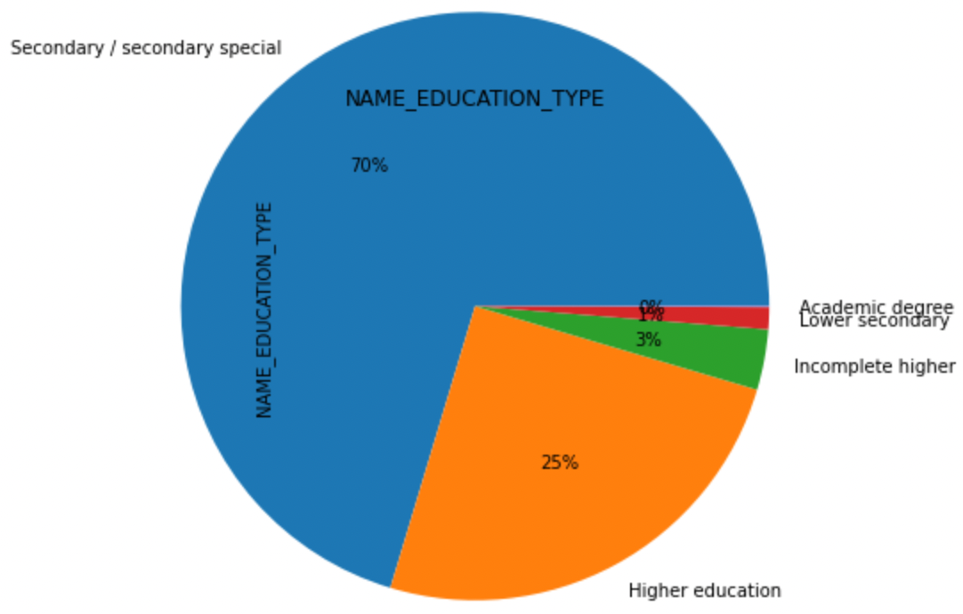
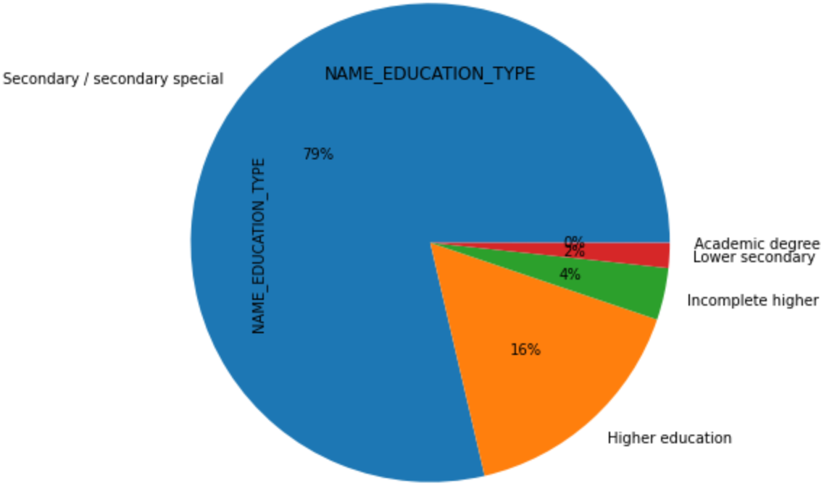
Univariate Analysis
A lot of defaulters and non defaulters from secondary education background. This shows that a lot of people have availed loans who belong to secondary education background.

Slide 15
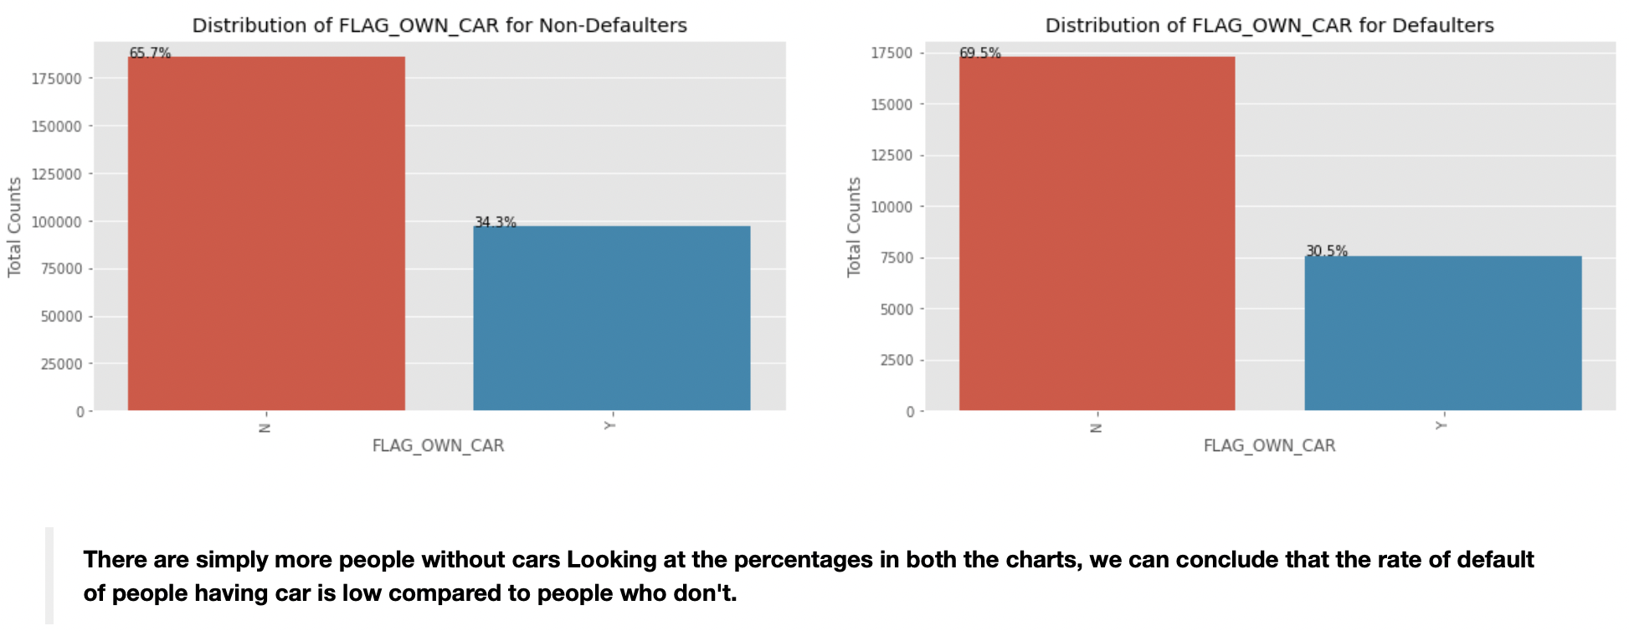
Univariate Analysis
If a person owns a CAR

Slide 16
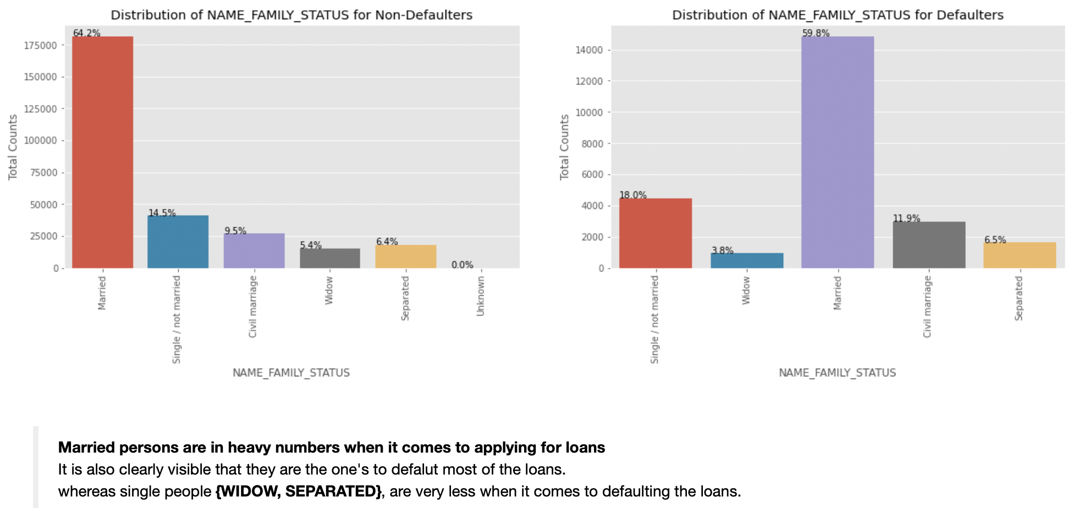
Univariate Analysis
On the basis of family status

Slide 17
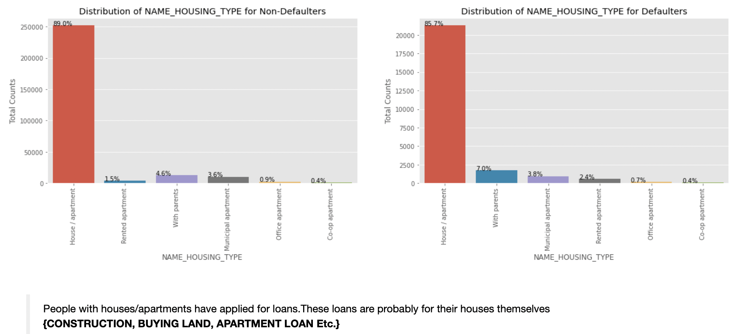
Univariate Analysis
On the basis of their HOME

Slide 18
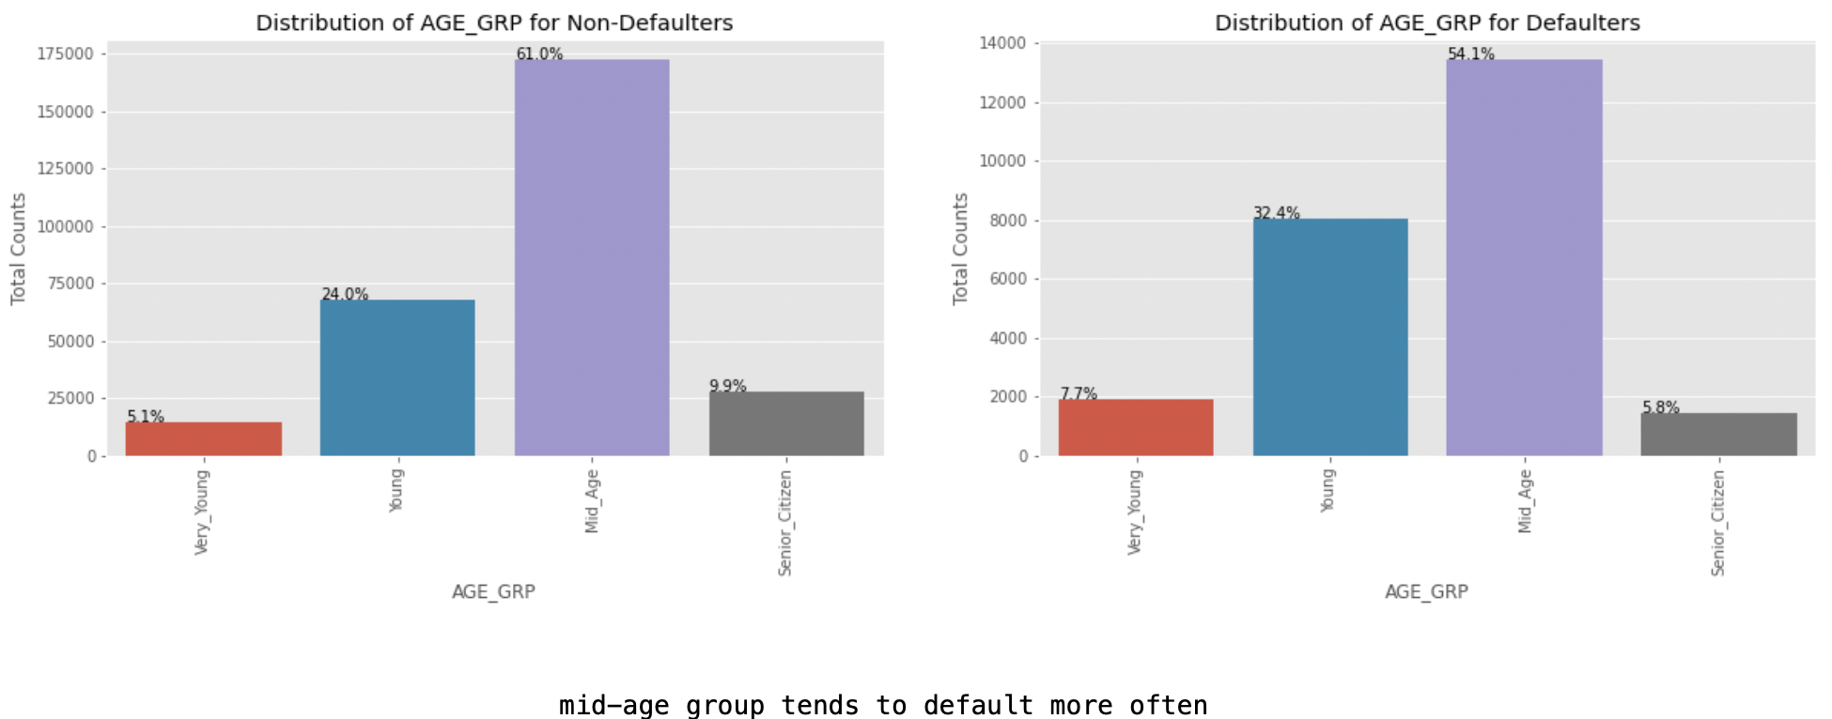
On the basis of AGE

Slide 19
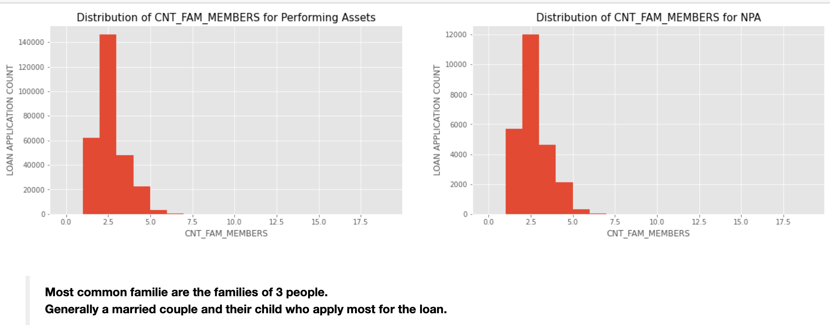
Univariate Analysis
On the basis of number of family members

Slide 20
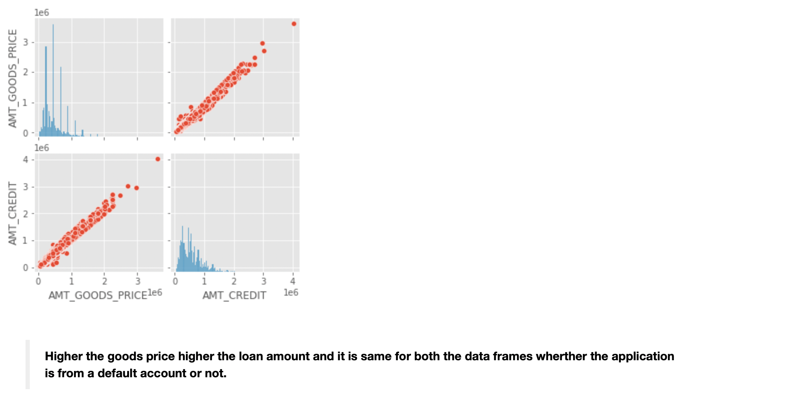
Bivariate Analysis
This is the distribution of credits on the basis of goods price which means the loan amount is decided on the basis of the price of the product which is to be purchased with the loaned amount.

Slide 21
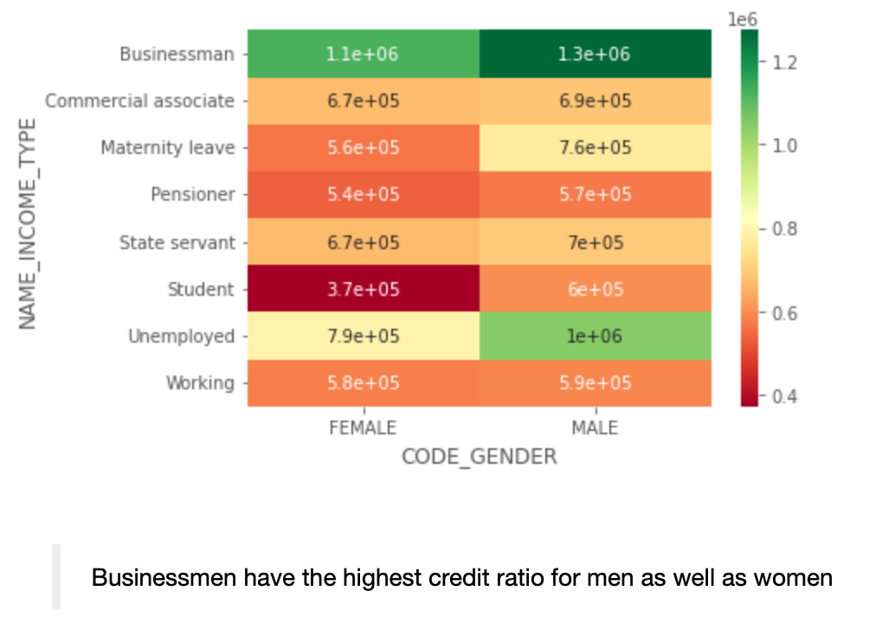
Bivariate Analysis
Distribution of credit to males and females on the basis of income type

Slide 22
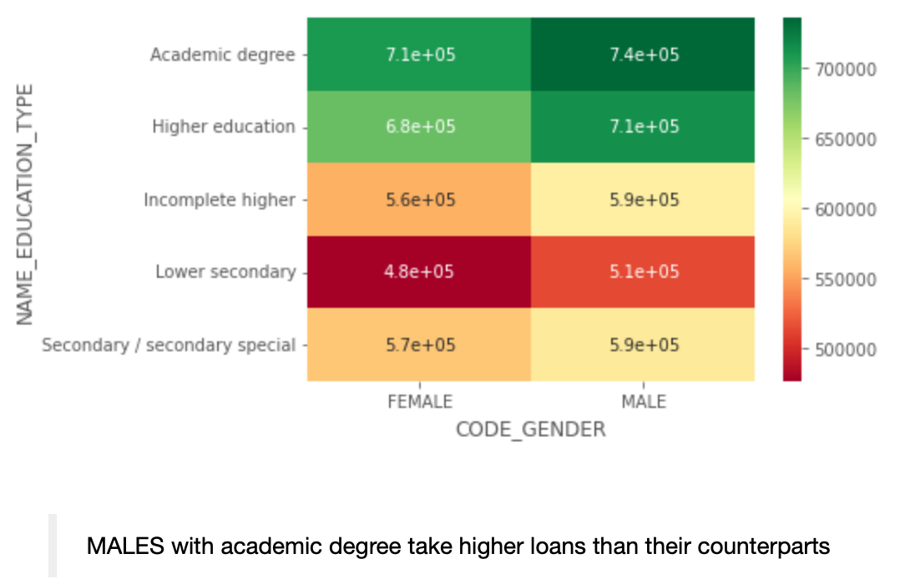
Bivariate Analysis
Distribution of credit to males and females on the basis of their education level

Slide 23
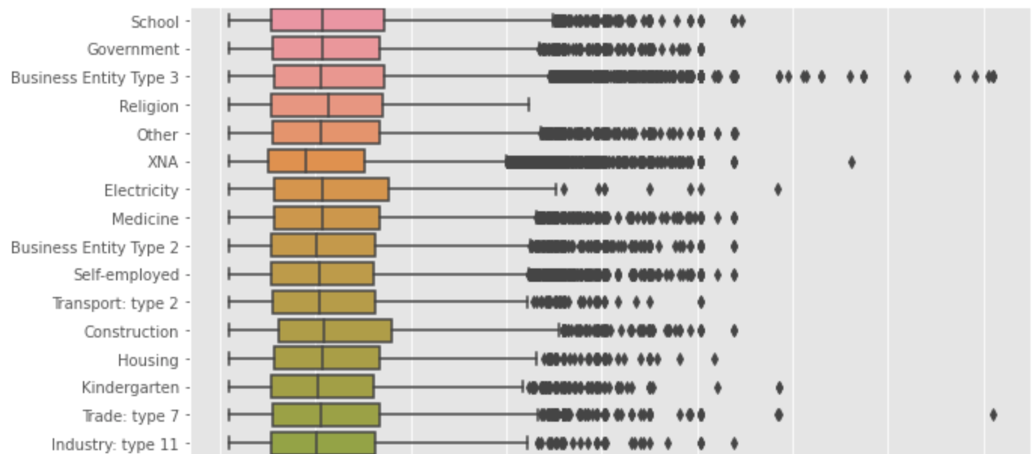
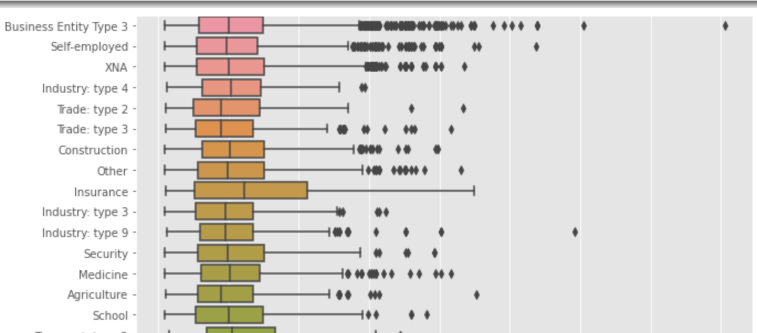
Bivariate Analysis
Business entity type3 has taken most amount of loans and has the most number of defaulters.
Insurance sector has no outlier values when it comes to credit repayment.
Non-defaulters
Defaulters

Slide 24
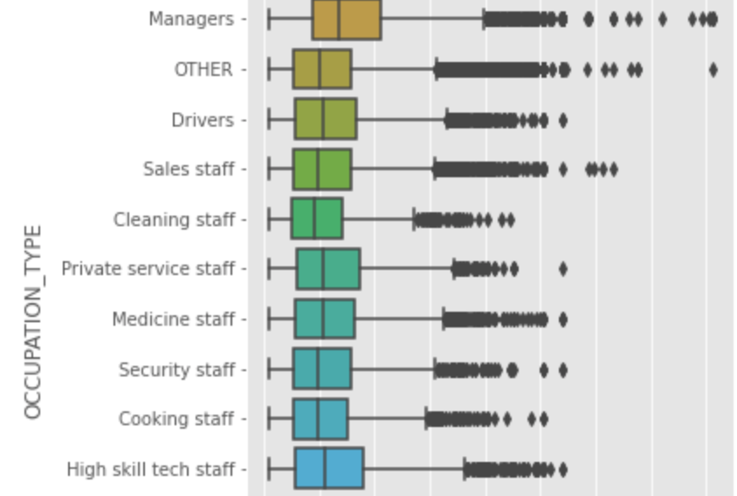
Bivariate Analysis
Clients who had occupation listed as managers took the highest number of loans.

Slide 25
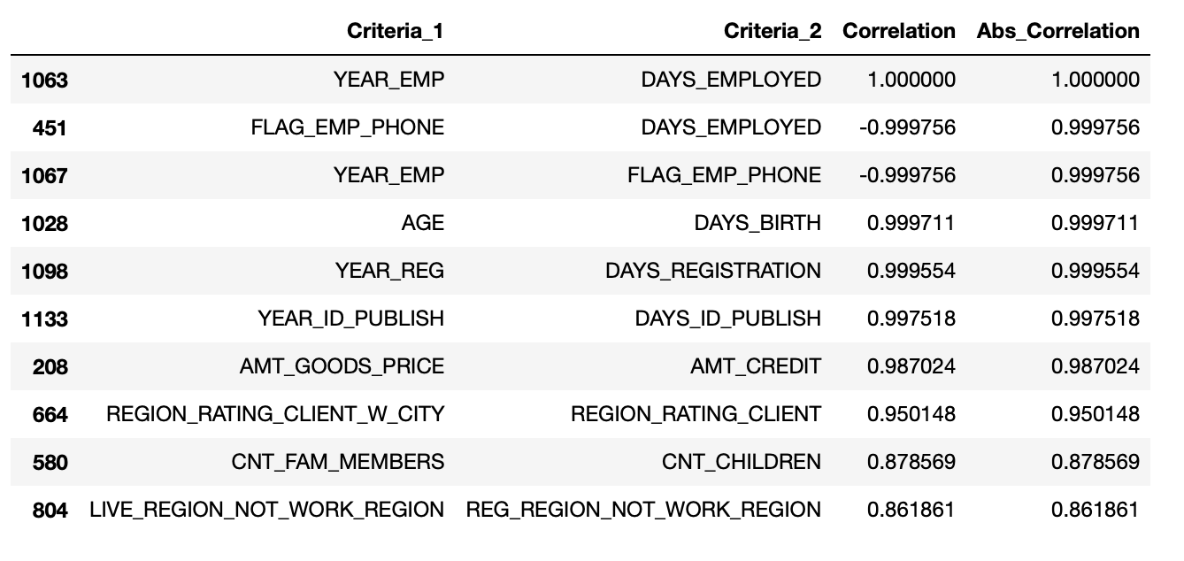
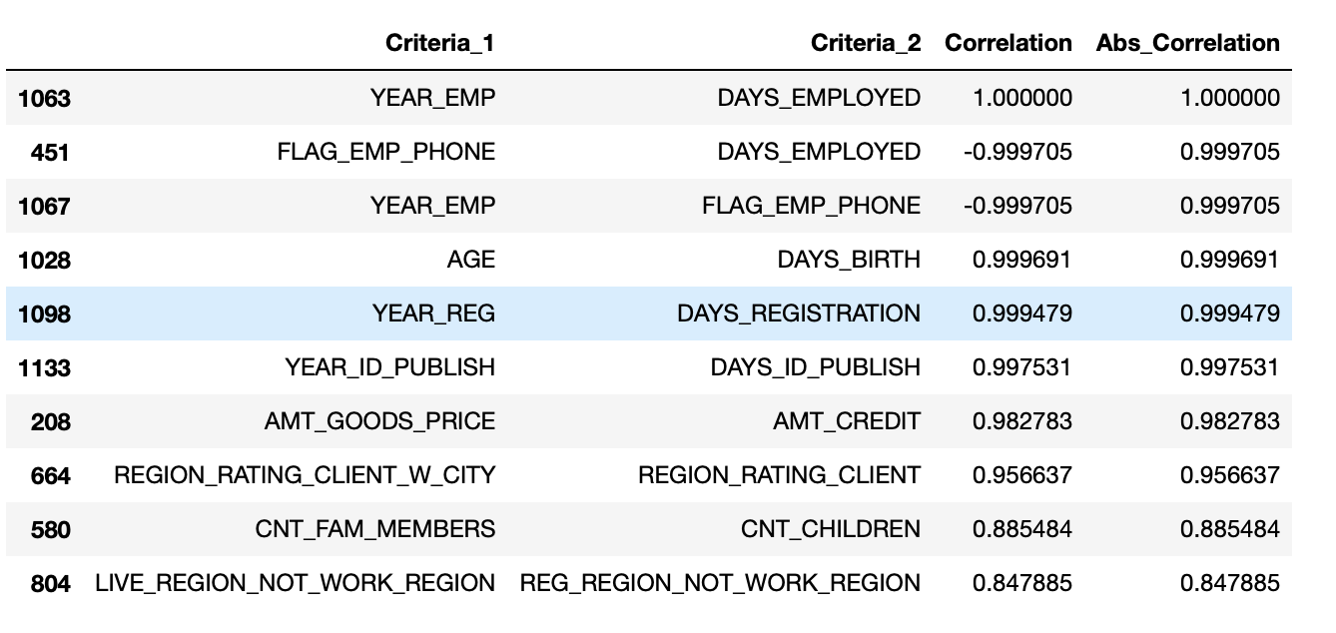
Correlation
TOP 10 Correlation for non-defaulters
TOP 10 Correlation for defaulters

Slide 26
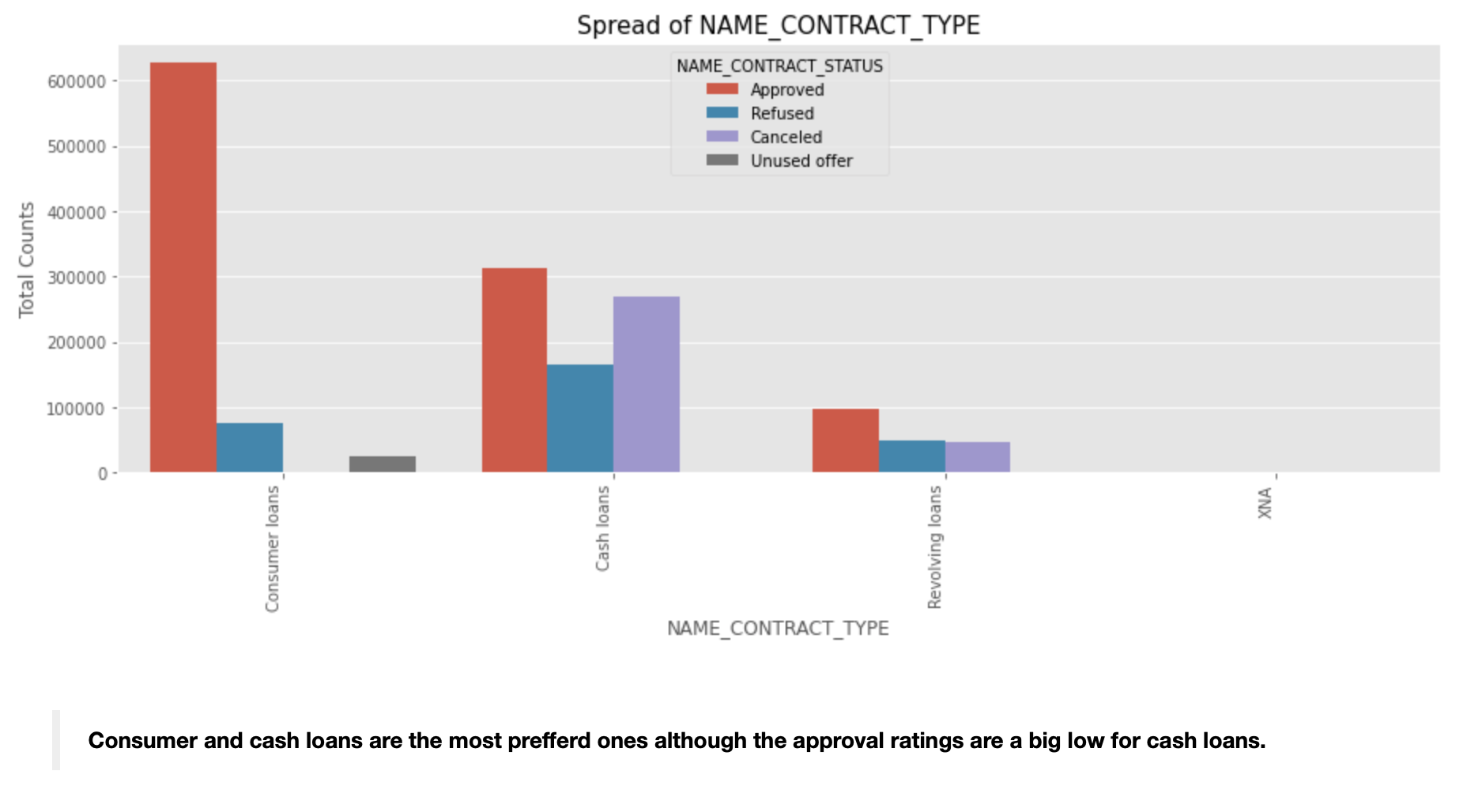
Pre-App Analysis

Slide 27
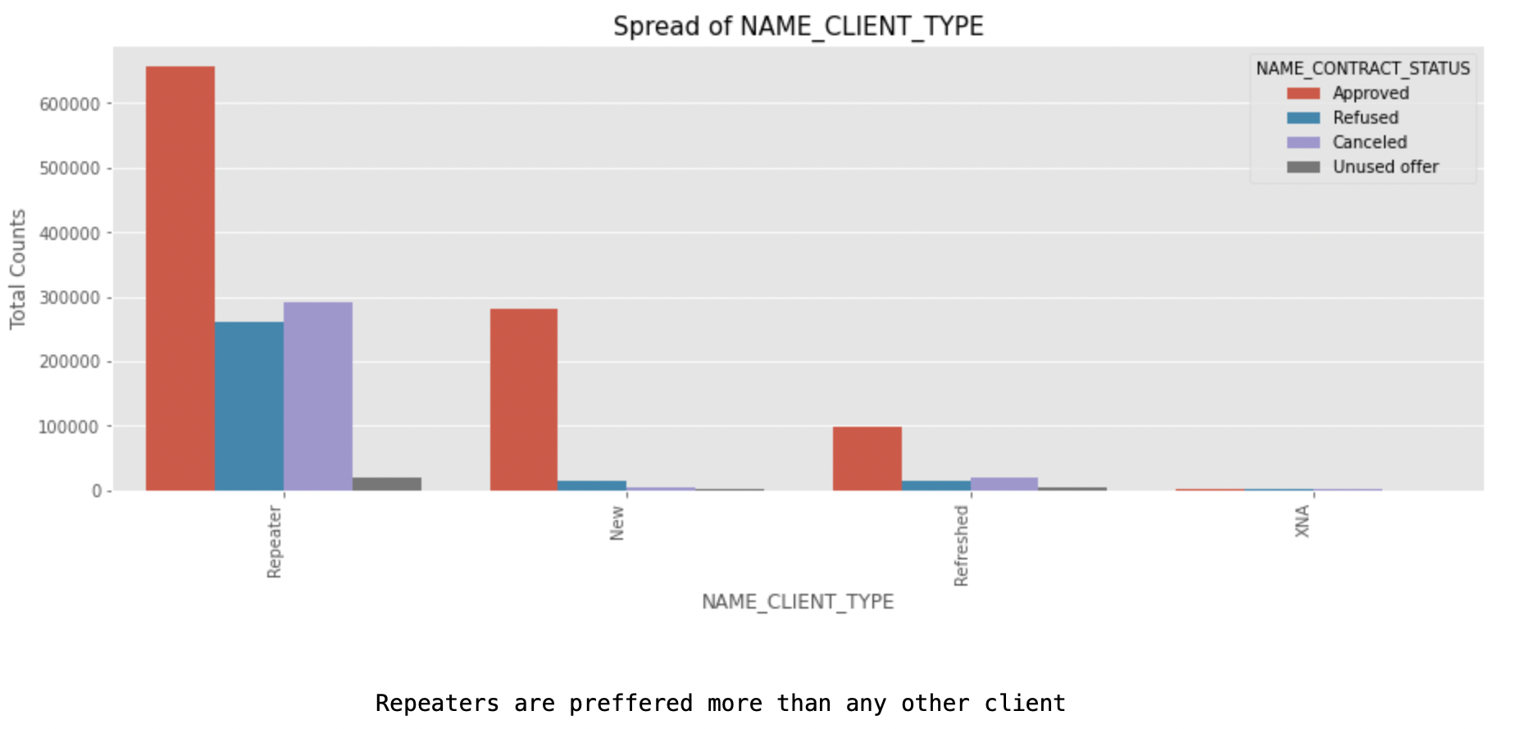
Pre-App Analysis

Slide 28
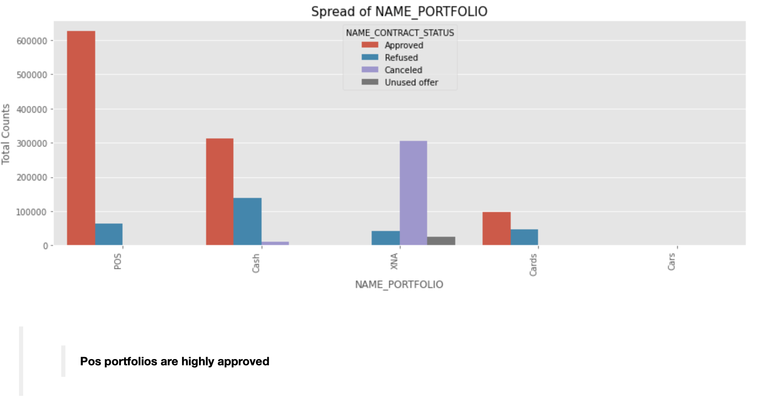
Pre-App Analysis

Slide 29
Merging
Merging the files previous application and new application and examining the data.
Inspecting and treatment of null-values.
Naming the file Target Clientele.

Slide 30
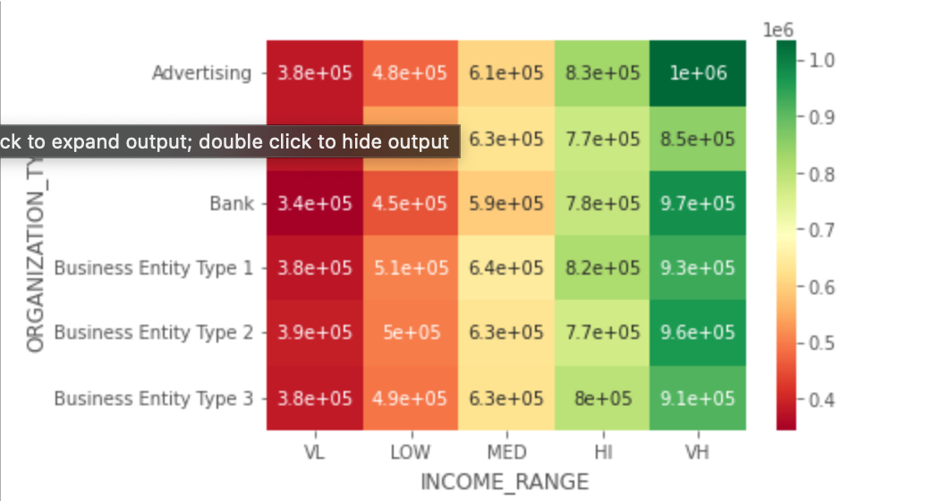
Target_Clientele

Slide 31
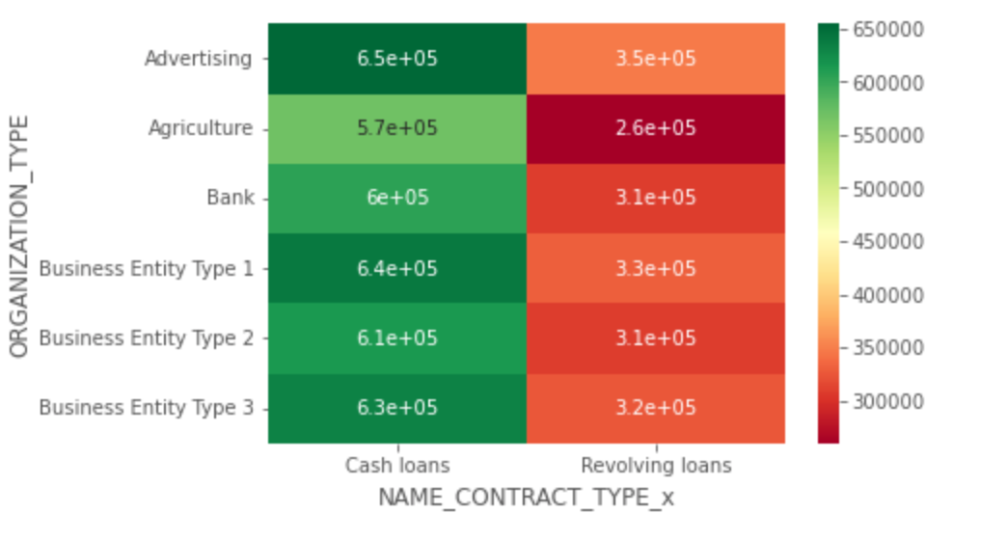
Target_Clientele

Slide 32
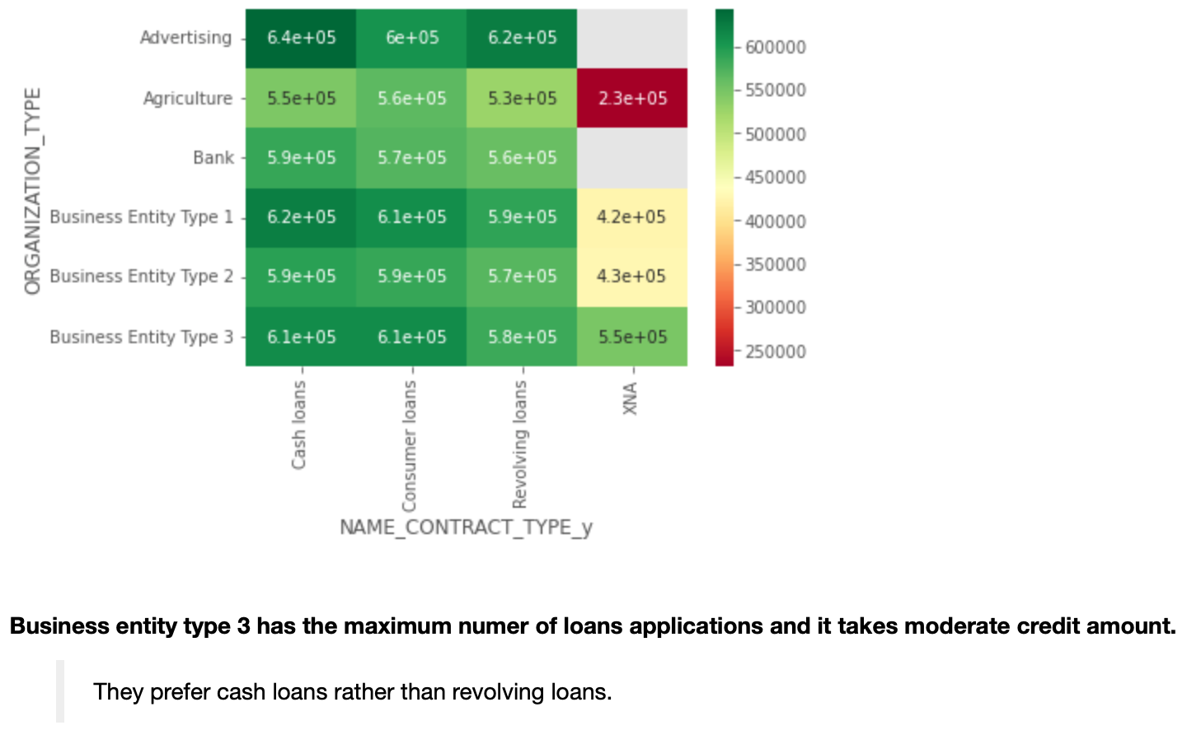
Target Clientele

Slide 33
Thankyou.

